Slide 1
The Use of Virtual Reality Rehabilitation for Individuals Post Stroke
Journal of Rehabilitation Therapy 2019
Impact Factor: 2.396

Slide 2
Introduction
1. Hemiparesis is a common consequence of a stroke which limits the functional performance and might persist for years.
2. After a stroke, the improvement of the balance is an important objective for physiotherapy and there is a growing need for more motivating treatments able to promote neurofunctional recovery and to improve treatment adherence.
3. This study aimed to verify the effects of a commercial video game (VG) with conventional physiotherapy in improving balance among individuals with chronic stroke.

Slide 3
Methods
1. Participants
(1) 28 individuals with chronic stroke from Ana Carolina Moura Xavier Rehabilitation Hospital and stroke outpatient department of the PUCPR University Physiotherapy Clinic.
(2) Inclusion criteria:
(a) Age above 18 years old.
(b) Unilateral stroke at least 6 months prior to recruitment.
(c) Residual hemiparetic deficits.
(d) Enrolled in a physiotherapeutic treatment.
(e) Able to walk with or without assistive devices.
(3) Exclusion criteria:
(a) Global or major receptive aphasia (失语症).
(b) Cognitive deficits.
(c) Neurological or orthopedic (骨科) disorders.
(d) Brunnstrom recovery stages 1, 2 or 3 and uncorrectable visual impairment.

Slide 4
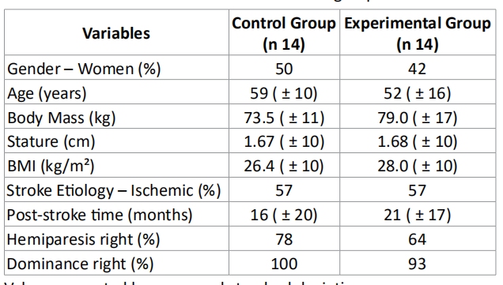

Slide 5
Methods
2. Intervention with the video game (VG)
(1) Nintendo® Wii Fit Plus.
(2) Three games with different difficulties
(a) Tightrope: walking on a tightrope.
(b) Balance Bubble: navigation in a bubble through a river.
(c) Penguin Slide: catching fish while balancing on a floating ice cube.
3. Procedure
(1) CG: conventional physiotherapy program (30 minutes a session of physical therapy twice
a week, 5 weeks in total).
(2) EG: conventional physiotherapy program + video games (both 30 minutes a session).

Slide 6
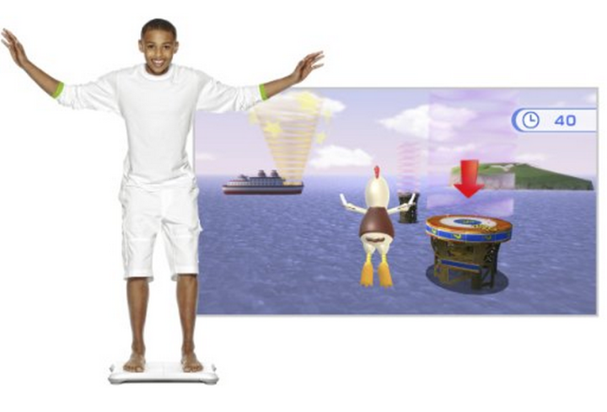

Slide 7
Methods
4. Five scales for balance meansurement
(1) The Berg Balance Scale (BBS).
(2) MiniBESTest.
(3) The Postural Assessment Scale for Stroke (PASS).
(4) The Functional Reach Test (FRT).
(5) The 1 Minute Stand-Sit Test (1-MSTST).

Slide 8
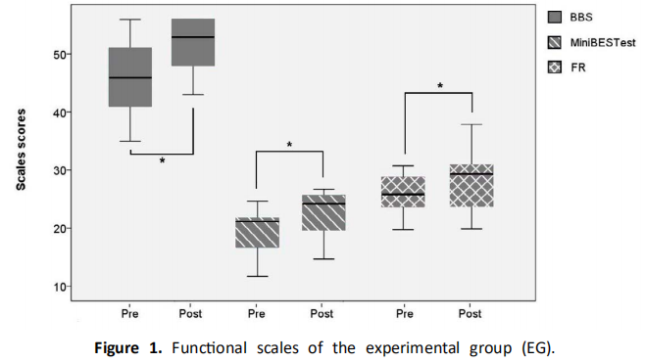
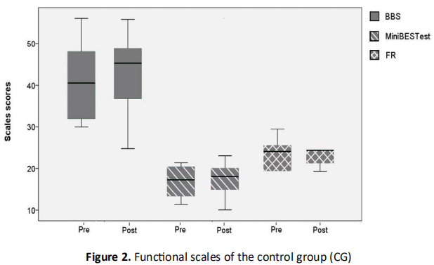
Results and Discussion
1. Statistically significant improvements were found in the experimental group for all measures except in the 1-MSTST.
2. VG assisted training was superior for increasing balance control according to the BBS, MiniBESTest.

Slide 9
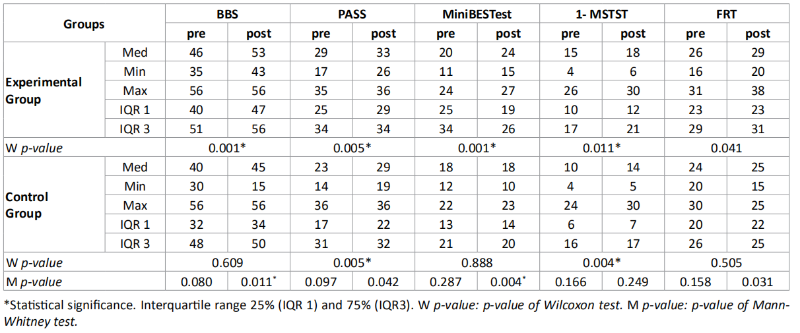

Slide 10
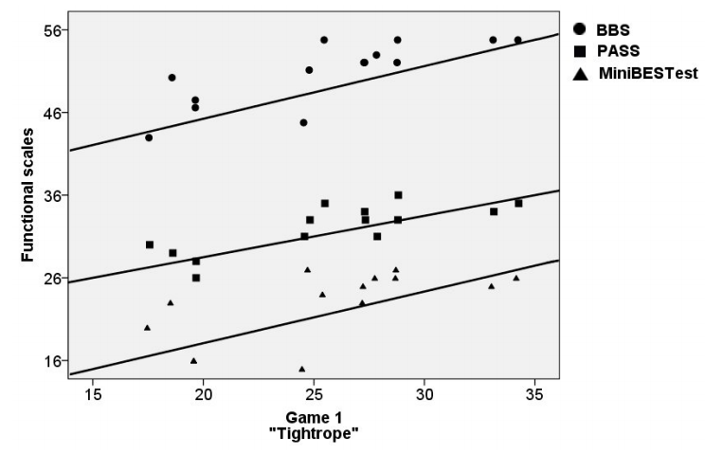
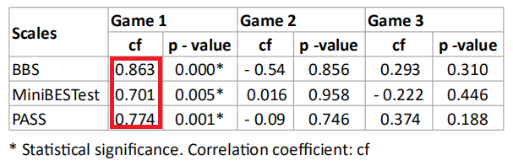
Results and Discussion
3. A positive and direct correlation between the scores of the game 1 - Tightrope and the BBS, MiniBESTest and PASS was found.

Slide 11
Conclusion
1. Training using video games showed significantly greater improvement in their balance than those who only received traditional rehabilitation therapy.
2. Video game exercise training combined with conventional training is a valuable tool for physiotherapy practice.

